Slide 1
Data Visualization of Bird Strikes between 2000 – 2011

Slide 2
AGENDA
Project Details
Objectives
Problem Statement
Process Flow
Insights
Collision Overview on State Map
Designed Visuals
Innovative Solutions
Conclusion

Slide 3
Project Details
Technology | Business Intelligence
Domain | E-commerce
Project Level | Advanced
Programming Language Used | Python, R Scripting
Tools/ Libraries used | Kaggle, MS-Excel, PowerBI, NumPy, Pandas, Matplotlib, Seaborn.

Slide 4
objectives
Emphasizing the Effects of Bird Strikes: Draw attention to the serious risk that bird strikes represent to aircraft safety by highlighting the potential for damage and previous incidents.
Examining Strike Patterns of Birds: Analyze data trends and patterns from FAA records from 2000 to 2011 to determine the most probable times and locations for bird strikes.
Safety and Environmental Issues: Talk about the safety and environmental issues that are raised by bird strikes in urban and transportation settings.
A Look at Technological Solutions Examine the creative ways that cutting-edge technologies, such as AI and MAS (Multi-Agent Systems), can reduce the likelihood of bird strikes.
Suggestions for Alleviation: Give stakeholders in aviation and urban development practical tactics and suggestions to successfully lower the number of bird strike events.
Prospective Courses: Provide suggestion for future lines of inquiry and technology developments that are required to enhance bird strike prevention and management.

Slide 5
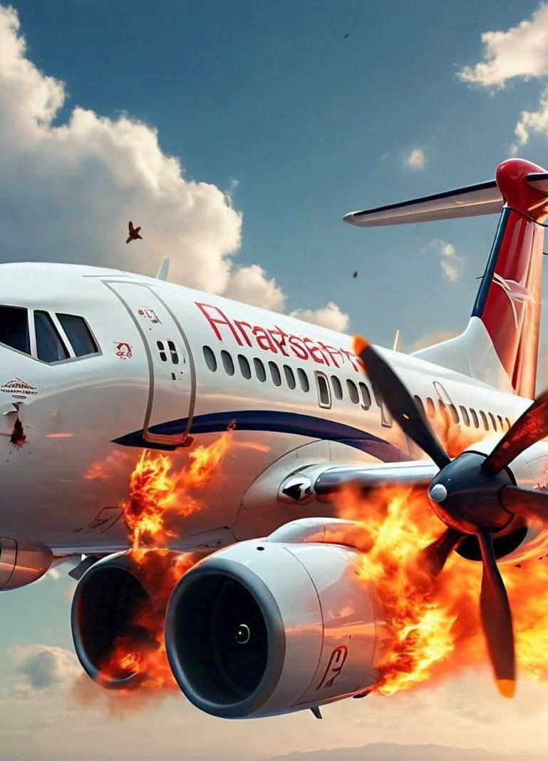
Problem statement
Significant Threat to Aircraft Safety: Bird strikes, which are defined as collisions between birds and aircraft, represent a serious threat to aircraft safety. These incidents can occur during crucial flight stages like takeoff, initial climb, approach, and landing, and they can result in serious injuries or even fatalities.
Increased Risk in Urban Areas: As urban areas expand, so does human and vehicle activity, which increases the frequency and severity of bird strikes. This calls for more thorough and efficient mitigation techniques.
Data Analysis for Insight and Action: It is essential to analyze FAA bird strike data from 2000 to 2011 in order to identify patterns and trends that will guide the creation of creative solutions that will improve aviation safety and reduce negative environmental effects.

Slide 6
Process flow
Data Exploration & Analysis
Analyzing the data visuals on Power Bi
Design Visualizations
Presenting the final conclusions
Data Collection
Data Cleaning & Preparation

Slide 7
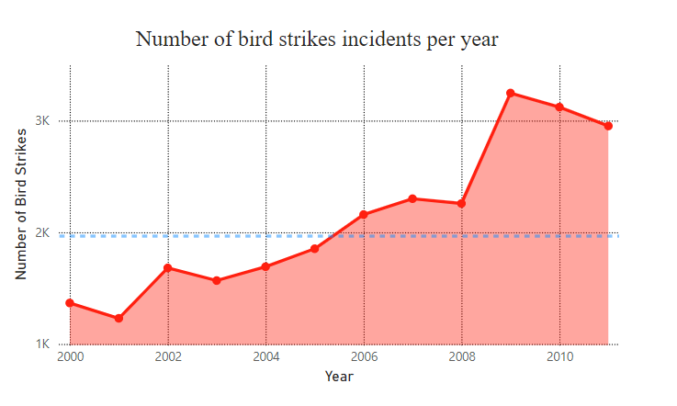
Insights
The illustrations show bird strikes that the FAA recorded between 2000 and 2011. The number of bird strikes annually is displayed in the chart. Beginning in 2000 at just over 1,000 instances, the figure varies somewhat until 2003, when it rises steadily. The number of events peaks in 2009 at just over 3,000, then declines somewhat in 2010 and 2011. This increasing trend over the past ten years indicates a rising concern for airplane safety.

Slide 8
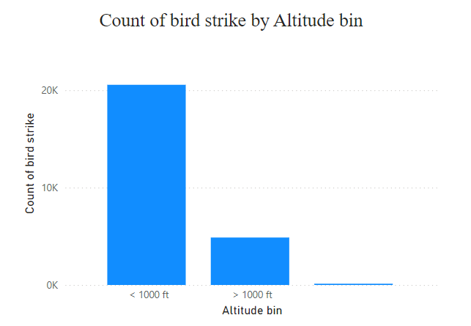
Insights
Bird strikes are categorized by altitude bins in the bar chart. With over 20,000 instances, the great majority of hits take place at elevations below 1,000 feet. Less than 5,000 occurrences of strikes have occurred over 1,000 feet, and the number of strikes above this height is insignificant. This distribution highlights the increased danger that occurs while aircraft are at lower altitudes, such as during takeoff, early ascent, approach, and landing.

Slide 9
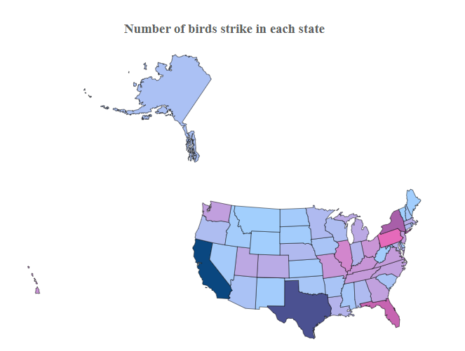
Collision overview on state map
The state of California is involved with most number of bird strikes in all of the USA at 6998 strikes , followed by Texas with 5983.
States like Montana received a comparatively low number of strikes.
In most of the cases aircraft involved was not a large aircraft
Size of birds was small in most of the cases of bird strikes followed by medium and then large.

Slide 10
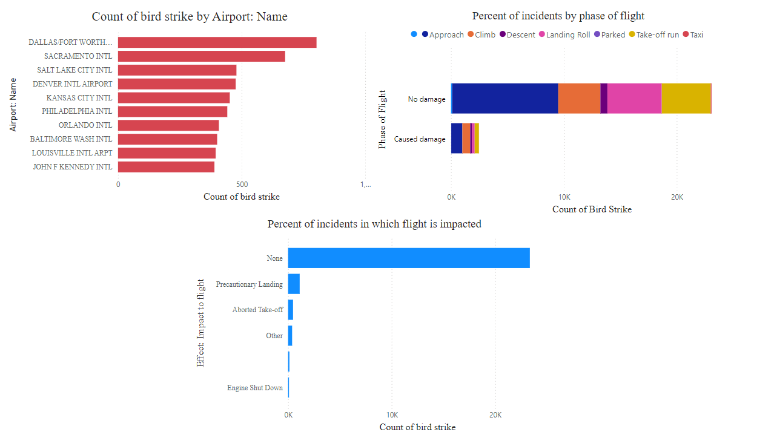
Designed visuals

Slide 11

INNOVATIVE SOLUTIONS

Slide 12
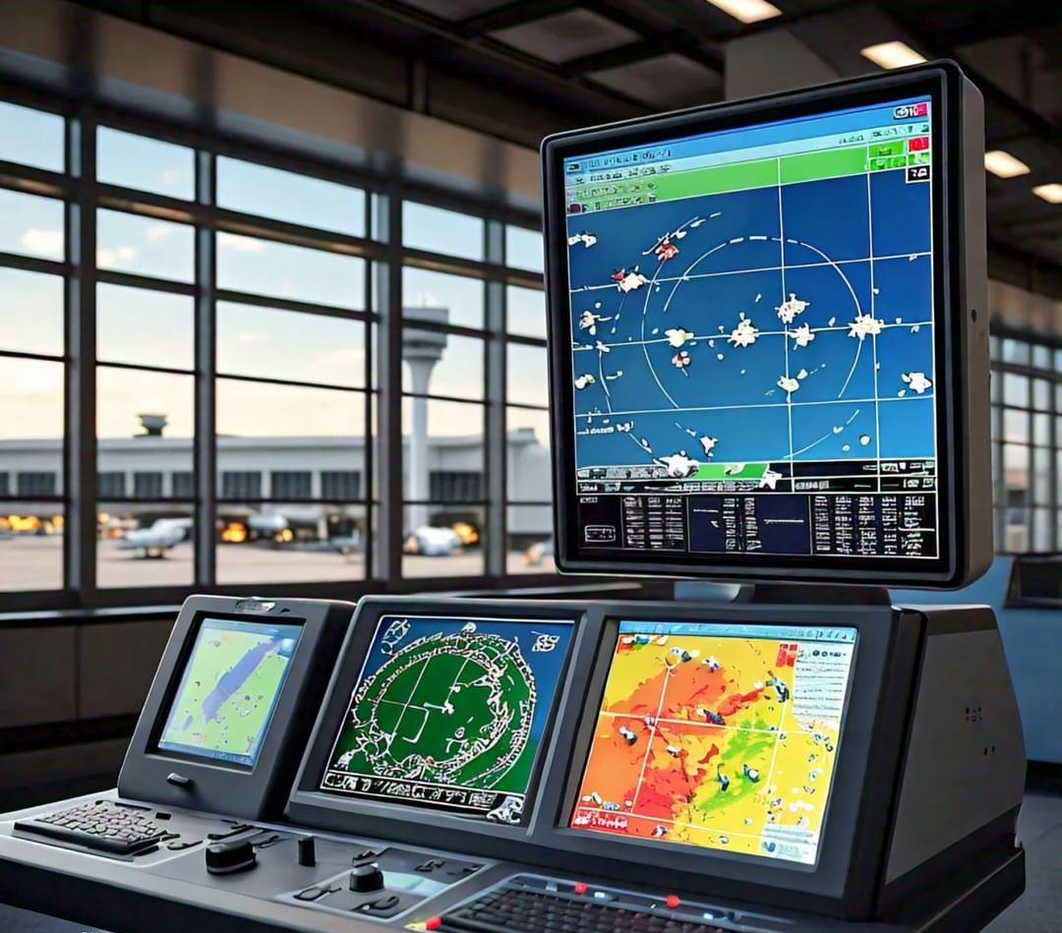
FUTURE INITIATIVES
Advanced Bird Detection Systems:
Radar and Lidar Technologies: Implement radar and lidar systems to detect birds in the vicinity of airports, providing real-time tracking and early warnings.
AI and Machine Learning: Use AI and machine learning to analyze radar data and predict bird movement patterns for proactive measures.

Slide 13
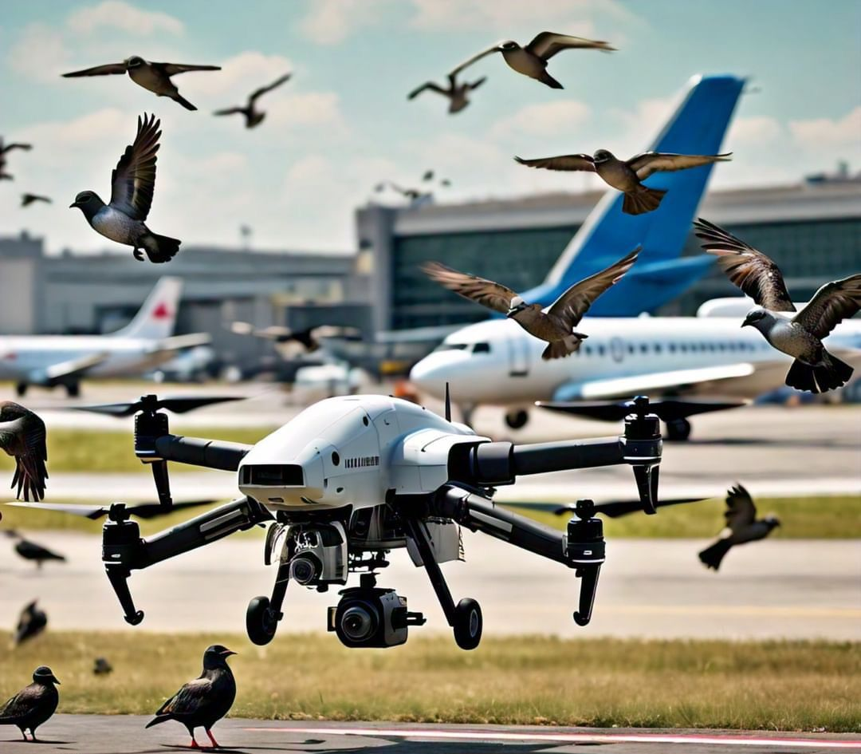
FUTURE INITIATIVES
Drone Patrols:
Autonomous Drones: Use drones to patrol airport grounds and surrounding areas to monitor and disperse bird flocks, equipped with visual and auditory deterrents.

Slide 14
FUTURE INITIATIVES
3. Others
a) Real-time Data Sharing Platforms: i)Centralized Bird Strike Data: Create a real-time data sharing platform for airports and airlines to report bird strike incidents and share effective mitigation strategies. ii) Predictive Analytics: Use data analytics to predict high-risk periods and locations for bird strikes, allowing for timely interventions.
b) Automated Bird Dispersal Systems: Laser Deterrents: i)Use automated laser systems to create an environment that birds find uncomfortable, encouraging them to avoid the area. ii)Sonic Deterrents: Deploy sound systems that emit distress calls or predator sounds to scare birds away from the airport.
c) Habitat Management: Landscaping Adjustments: i)Modify the landscaping around airports to make it less attractive to birds, such as eliminating standing water and planting vegetation that birds do not favor. ii)Exclusion Techniques: Install netting or other physical barriers to prevent birds from accessing certain areas.

Slide 15
Conclusion
High Incidence of Bird Strikes: Over an 11-year period, there were approximately 25,000 bird strikes, resulting in a repair cost of $136 million.
Minor Damage Predominates: Of the 24,747 flights involved in bird strikes, 22,363 received no damage, while 2,384 experienced varying degrees of damage.
Increasing Trend: The number of bird strikes increased annually from 2000 to 2011.
Affected Airlines: Airlines such as Business, Southwest Airlines, American Airlines, Delta Airlines, and US Airlines are more frequently involved in bird strikes.
Altitude Factor: 81% of bird strikes occurred at altitudes below 1,000 feet, while 19% occurred above 1,000 feet.
Top Airports: DALLAS/FORT WORTH INTL AIRPORT reported the highest number of bird strikes (802), followed by SACRAMENTO INTL (676). Other high-incident airports include SALT LAKE CITY (479), DENVER INTL (476), KANSAS CITY INTL (452), and PHILADELPHIA INTL (442).
Weather Conditions: Weather such as rain, fog, or snow had little to no impact on bird strikes, with most occurring during fine weather.

Slide 16
Conclusion
Critical Phases of Flight: Bird strikes were most common when planes were approaching the runway, with additional incidents occurring during takeoff, landing, climbing, and descent. Strikes were rare during parking or taxiing.
Pilot Awareness: In 52% of cases, pilots were unaware of potential bird strikes, whereas in 47% of cases, they had been informed beforehand.
Impact on Flights: 81% of bird strikes resulted in no damage to the aircraft or disruption to the flight schedule. However, 9.59% led to precautionary landings, 3.21% caused aborted takeoffs, and 2.21% resulted in engine shutdowns.
Altitude of Strikes: The average altitude at which most bird strikes occurred was 800 feet above the ground.
State Statistics: California reported the highest number of bird strikes (6,998), followed by Texas (5,983), while states like Montana had relatively few strikes.
Aircraft and Bird Size: Most bird strikes involved smaller aircraft, and the majority of the birds involved were small, followed by medium and large-sized birds.

Slide 17
Thank you
Zeeshan Khan
zk2938560@gmail.com https://www.linkedin.com/in/zeeshan-khan-72110/
© All images in this presentation have been generated or imagined with the help of AI

